Slide 1
Reward Shaping For UCI Dataset

Slide 2
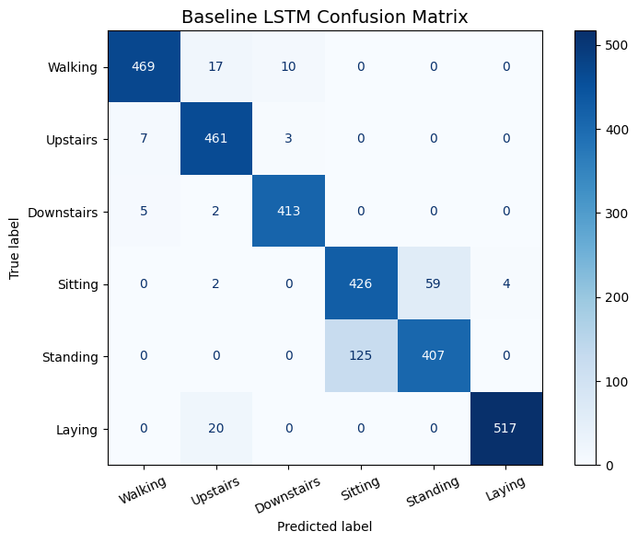
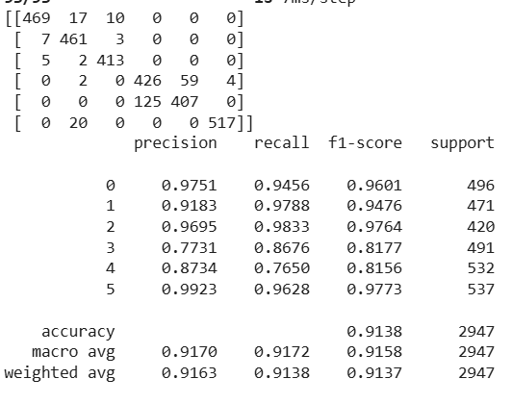
Results for LSTM [ baseline ]
Accuracy = 91.38%

Slide 3
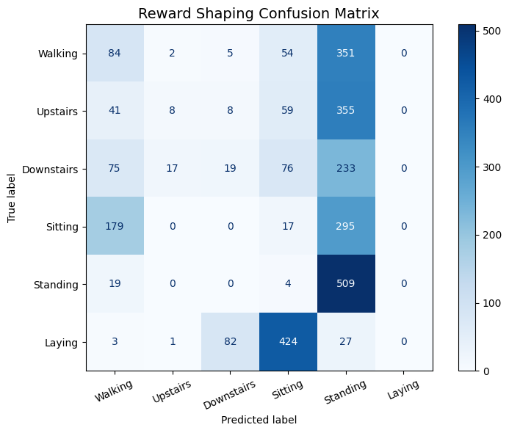
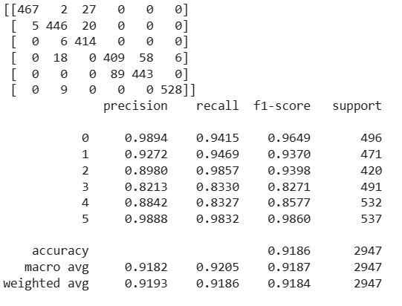
Results for LSTM with Reward Shaping
Accuracy = 91.8%

